Slide 1
Identifying Low-Risk Aircraft for Expansion into Aviation Business

Slide 2
agenda
Problem Statement
Data Understanding
Results & Findings
Recommendations

Slide 3
Problem Statement:
As the company considers expanding into the commercial and private aviation sectors, it is essential to evaluate the risks linked to various aircraft types.
This analysis reviews historical aviation data to identify trends in accidents and fatalities, providing insights to support risk-aware aircraft acquisition decisions.
The following questions guided the objectivity of the analysis, aligned with the main risk areas identified:
Safety risks - What are the historical accident and fatality rates for each aircraft type ?
Risk of aircraft damage - How frequently do different aircraft types experience damage incidents and what is the extent or severity of the damage?
External risks - To what extent do external factors (e.g., weather) contribute to accidents and operational disruptions?

Slide 4
Data Understanding:
Data Source:
The dataset was sourced from the National Transportation Safety Board and contains historical aviation safety records of incidents and accidents involving various aircraft types, starting from 1962.
Data Preparations:
To ensure the data reflected modern aviation standards, records from 2012 to 2022 were selected. Given the significant evolution in aviation technology, safety practices, and regulations since 1962, older records may not accurately represent current industry realities. The dataset was also cleaned to remove inconsistencies, incomplete entries, and irrelevant fields, enhancing the quality and reliability of the analysis.
Relevance to Analysis:
This dataset offers valuable insights into accident trends, fatality rates, and aircraft damage, enabling an assessment of the risk profiles of different aircraft types to support informed decision-making.

Slide 5
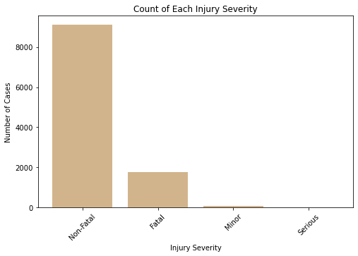
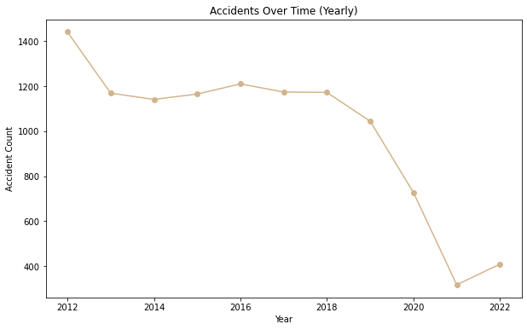
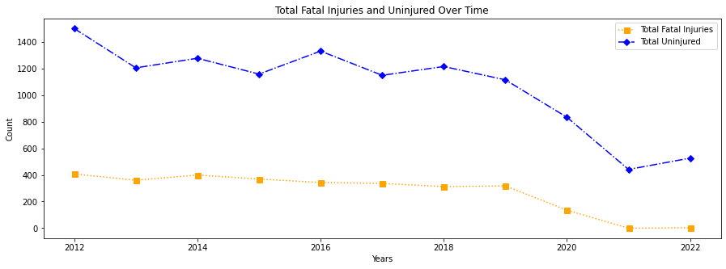
Results & Findings:
1. Safety:
To assess the severity of accidents, several analyses were conducted, including a count of each injury severity, accident trends over time, and the evolution of fatal injuries and uninjured individuals over the years. The charts below highlight these findings, showcasing the differences and trends in accident severity.

Slide 6
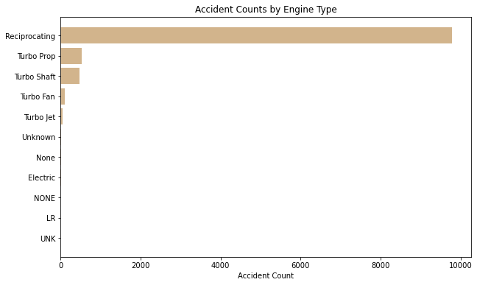
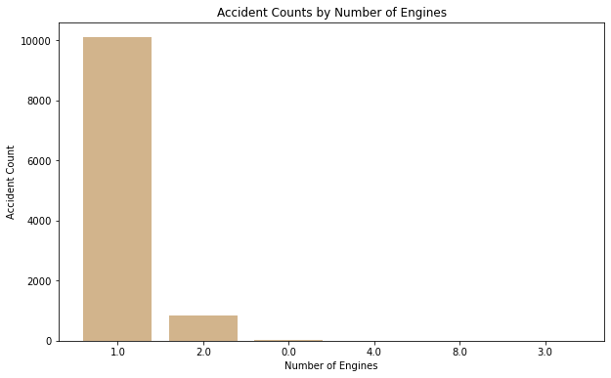
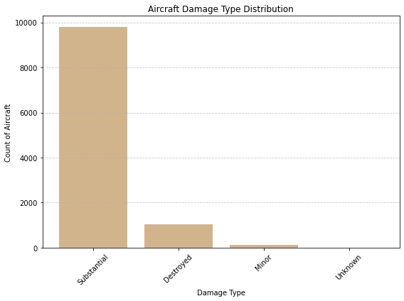
Results & Findings:
2. Reliability:
To evaluate the risk associated with specific type of aircraft, the registration number, make, model and the extent of different aircraft was analysed. Number of engines and engine type was also considered, as certain configurations may be more prone to accidents, influencing the overall risk factor.

Slide 7
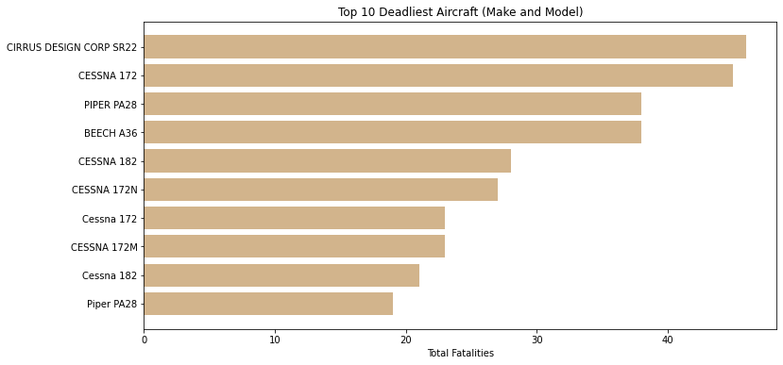
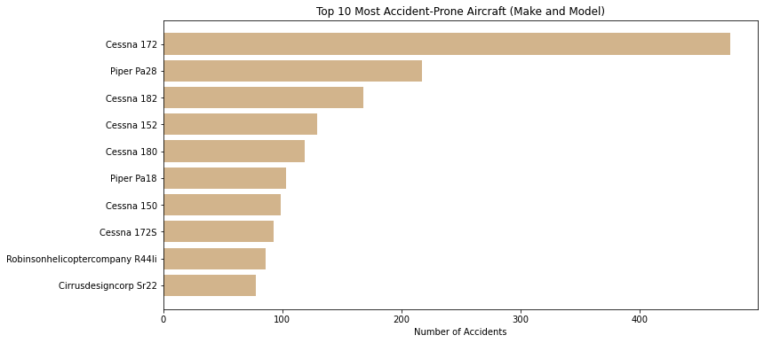
Results & Findings:
Make & Model Combination:
An analysis of make and model combinations was conducted to determine accident counts for each pairing. This helped identify which combinations were most and least prone to accidents. Combinations associated with a higher frequency of fatal accidents were highlighted, providing further insight into aircraft types that pose greater safety risks.

Slide 8
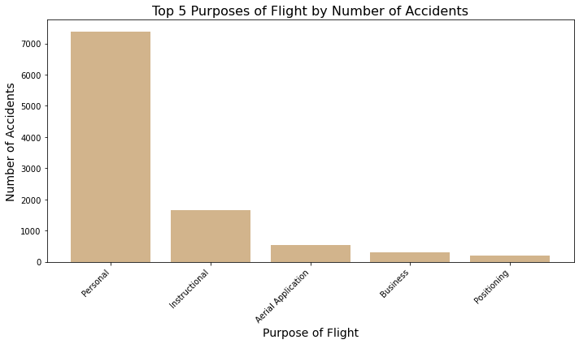
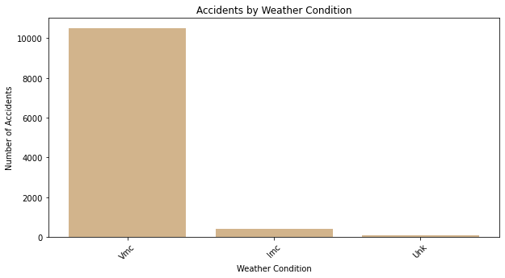
Results & Findings:
3. Operational Planning Risk:
To offer a more comprehensive risk assessment, the analysis examined whether certain flight purposes (e.g., personal vs. commercial) contribute to higher accident risks. I considered the impact of weather conditions and if it can significantly influence safety, reliability, and aircraft performance, thereby increasing the likelihood of incidents.

Slide 9
Results & Findings:
Observations:
Aircraft with one or two engines accounted for the highest number of accidents, while aircraft equipped with eight engines showed significantly no accident, suggesting that a higher number of engines may contribute to greater safety.
In terms of engine type, aircraft with reciprocating engines and turbo variants (turbo-prop, turbo-shaft, turbo-fan, turbo-jet) experienced the most accidents. In contrast, aircraft powered by electric engines recorded the least accidents, indicating a higher level of safety.
Majority of aircraft makes and models experienced either substantial or complete damage during incidents, indicating a higher level of risk associated with acquiring them. Only a few aircraft types recorded minor or no damage, suggesting a lower risk profile.
Overall, aviation safety has shown improvement in recent years, indicating advancements in industry standards and practices. The number of non-fatal incidents consistently exceeded fatal incidents, which is a positive sign. The injury severity has also been decreasing over time, further highlighting the progress made in enhancing aviation safety.
Although the Cessna 172 aircraft recorded the highest number of accidents (476), the Cirrus Design Corp SR22 had fewer total accidents (78) but accounted for the highest number of fatal accidents, making it the deadliest aircraft.
Aircrafts with minimal accidents such as the Rans S6S, Hawk Arrow II, Kitfox Super Sport suggests that factors like design, usage, or operational procedures may contribute to their safety.
The Quicksilver aircraft make has been involved in a notably high number of incidents counts suggesting a greater need for frequent maintenance, raising concerns about its long-term reliability.
Aircraft engaged in personal and instructional activities exhibited a significantly higher number of incidents, indicating greater exposure to risk compared to other types of flight operations. Specialized aircraft missions such as firefighting, air drops, and glider towing reported relatively low incident rates.
Weather conditions have a significant impact on aviation accidents. Visual Meteorological conditions (VMC) are associated with the highest number of accidents, likely due to increased flight activity.

Slide 10
Recommendations:
Prioritize Aircraft with higher engines counts and Electric Engine for improved Safety and Reliability:
Focusing on aircraft with more engines has shown to significantly reduce the risk of accidents, indicating a clear correlation between the number of engines and improved safety. To further enhance safety and minimize operational risks, it is recommended that the company prioritize acquiring aircraft with higher engine counts.
Transitioning to electric engine for new fleet acquisitions improves safety while reducing long-term operational costs. This shift would not only boost reliability but also position the company as a forward-thinking player in the evolving aviation industry.
Make & Model Combinations
Purchasing aircraft based on historical safety performance, accident records, and maintenance requirements is essential to reduce operational risks and ensure long-term reliability.
it is advised that the company avoid acquiring aircraft like the Quicksilver, which has been associated with a higher number of incidents, or any aircraft linked to fatal accidents. Instead, the company should prioritize aircraft models with fewer or no accidents. Aircrafts such as the Cessna T210L and Beech B23, exhibit greater durability therefore should be considered safer options.
Strategic Recommendations for Improving Aircraft Safety and Minimizing Risk:
The company should develop operational strategies that prioritize Instrument Meteorological Conditions (IMC), as these conditions have been associated with fewer accidents compared to Visual Meteorological Conditions (VMC). When planning flight purposes, it is advisable to focus on specialized aircraft missions, such as firefighting, air drops, and glider towing, which have shown lower incident rates. In contrast, aircraft used for personal and instructional activities have exhibited a significantly higher number of incidents, highlighting the greater exposure to risk associated with these types of flights.

Slide 11

THANK YOU !
Hafsa M.Aden
Hafsa.mohammed.aden@gmail.com

